Slide 1
DESIGN PROPOSAL
EE314 TERM PROJECT
Afer OLKAY - 2305126
Hüseyin -2XXXXXX
Mustafa -2XXXXXX

Slide 2
Overall Module
Necessary variable are defined here:
input [3:0] input_data;
reg [5:0] buffer_1,buffer_2, …. ;
etc.
Module 1
Problem: How to get data and place it in a buffer correctly?
Module 2
Problem: Which buffer to choose to take data from?
Module 3
Problem: How to print data to the screen?

Slide 3
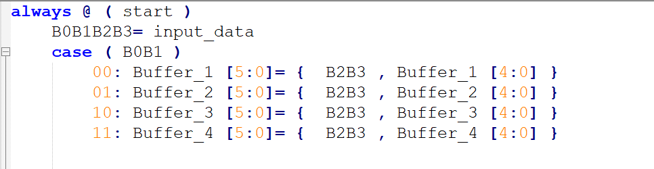
Module 1
Problem: How to get data and place&store it in a buffer correctly?
-In this module we will make sure the data that is inputted are accepted into the circuitry whenever ‘start’ is pushed and placed in the correct buffer with correct color and number.

Slide 4
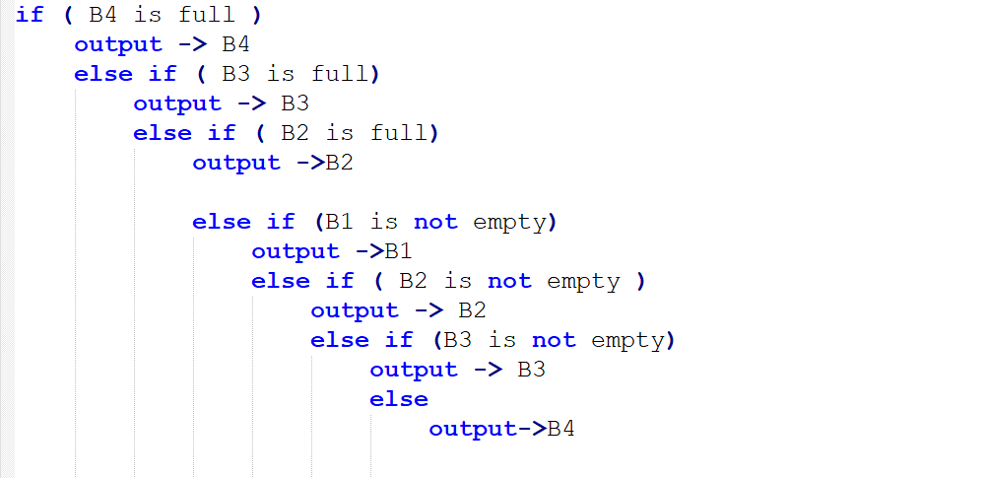
Module 2
Problem: Which buffer to choose from to take data from?
-We know that every three second, a data must be choosen to be outputted. We we need to create an algorithm to choose from which buffer to take the data from so that the latency and reliablity requirements are satisfied as much as possible.
for reliability
for latency

Slide 5
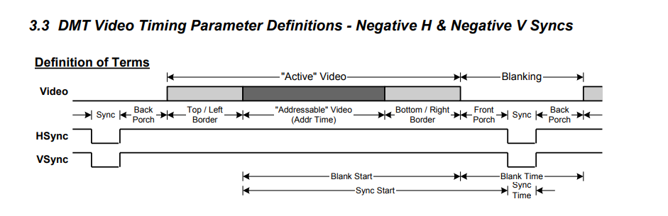
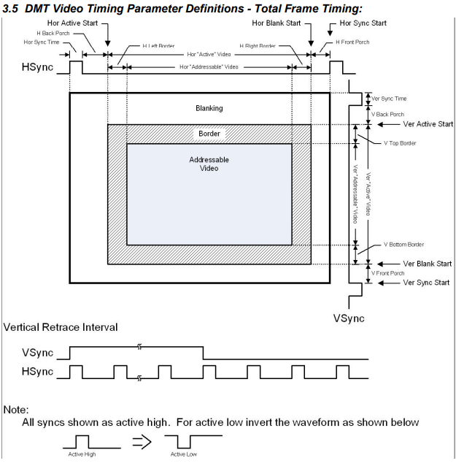
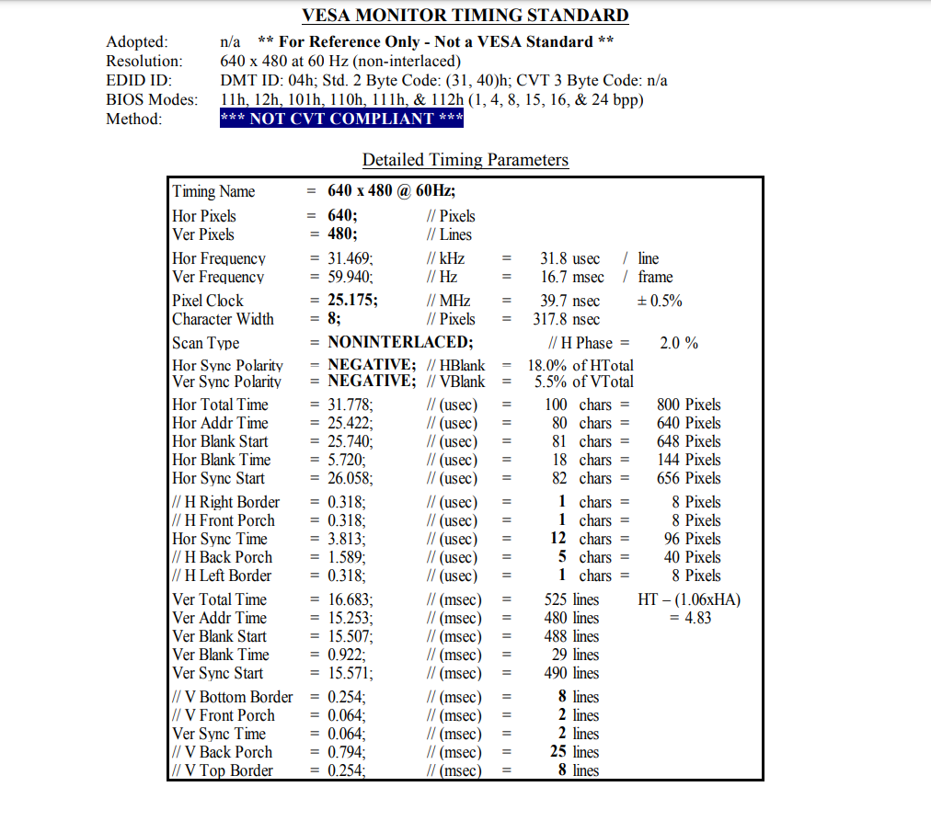
Module 3
Problem: How to print data to the screen?
-After the internal of the QoS system is finalized, we’ll need the monitor the system and transfer it to a screen. We will do it using a VGA interface and a 640x480 pixel screen.
Taken from VESA and Industry Standards and Guidelines for Computer Display Monitor Timing (DMT)

Slide 6
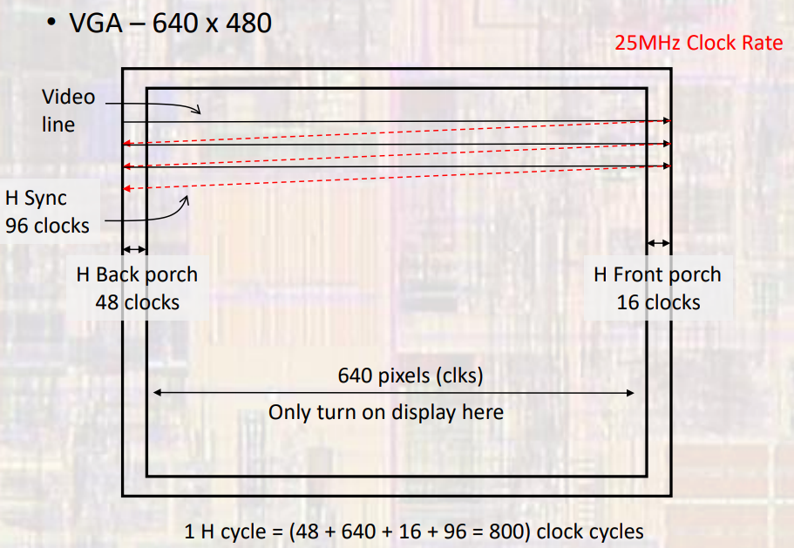
Module 3
Taken from Milwaukee School of Engineering EE3921 lecture slides

Slide 7
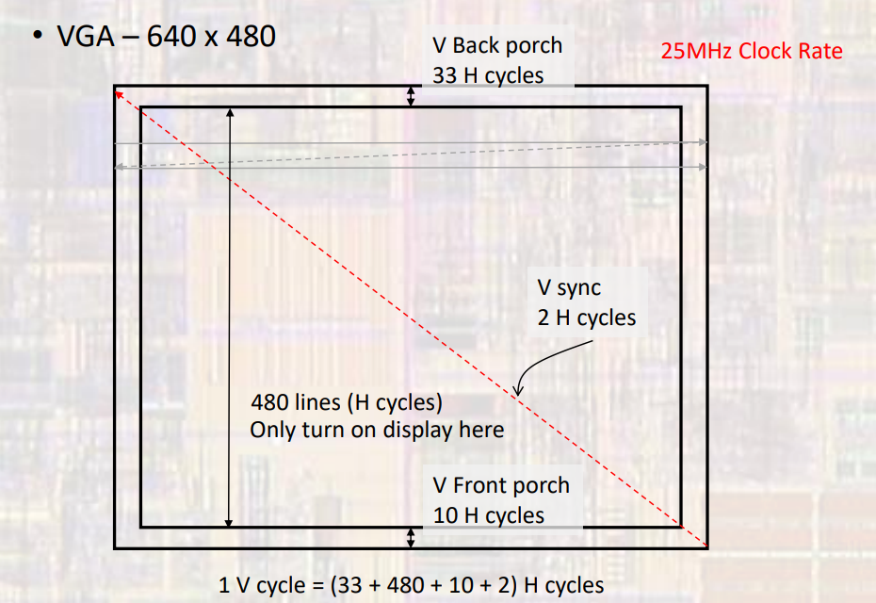
Module 3
Taken from Milwaukee School of Engineering EE3921 lecture slides

Slide 8
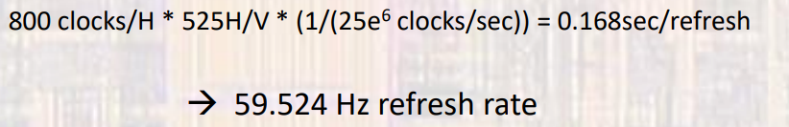
Module 3

Slide 9
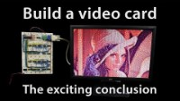
Module 3
Taken from Youtube Channel of Ben Eater

